Slide 1
Spring 2021 First Steps

Slide 2
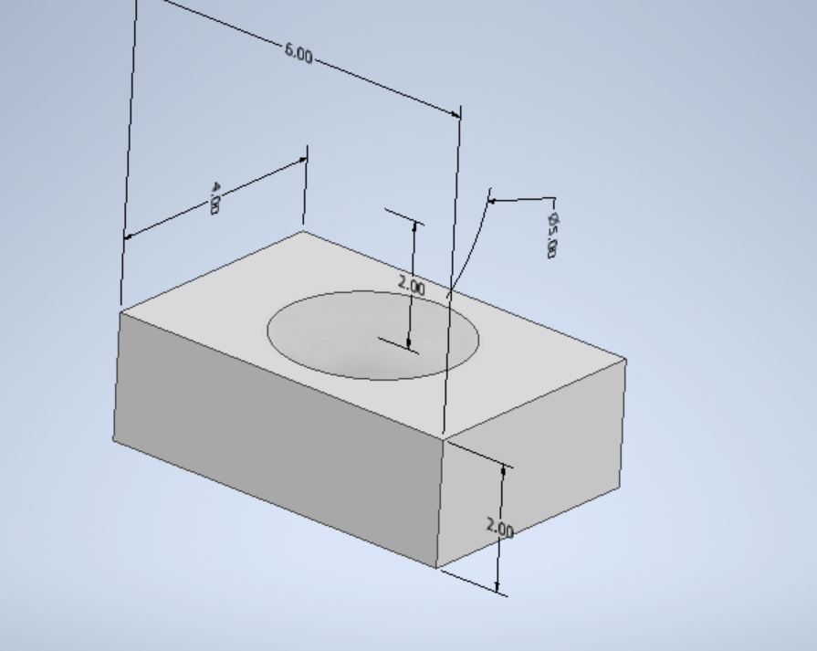
Sample Check In
All of the original test samples are printed and in the process of being tested
Need to track down the aluminum bar
Next steps
Print T1 samples for compression testing (just 100% infill to save testing space)
Print T4 samples for compression and tension at 100% infill
36 total (12 for T1 and 24 for T4)
3 active printers, 2 prints per day, 36 prints could be done by next Wednesday
Issue is testing, need to figure out a solution

Slide 3
Variables to change
Next steps after T4 (all would be at 100% infill):
More shapes (T2/T3 or other designs)
Infill patterns (Hexagonal, triangular, etc)
Different materials (Carbon fiber)

Slide 4
Possibility of getting a second testing set up
At this rate we will have an excess of samples and not enough tests
Still have budget that needs to be used
Look into using the Kim lab?

Slide 5
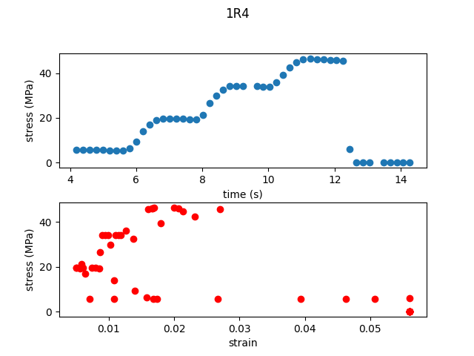
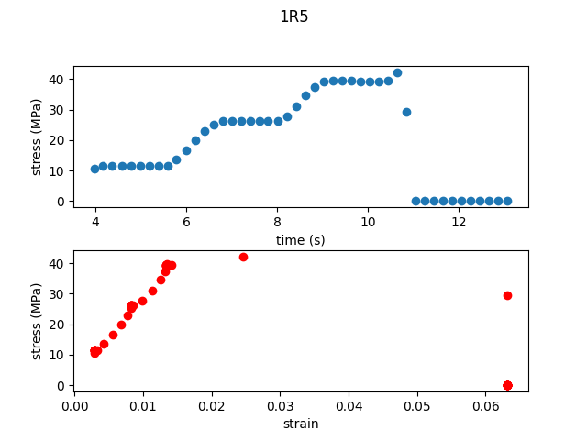
Repaired
Something wrong with strain here

Slide 6
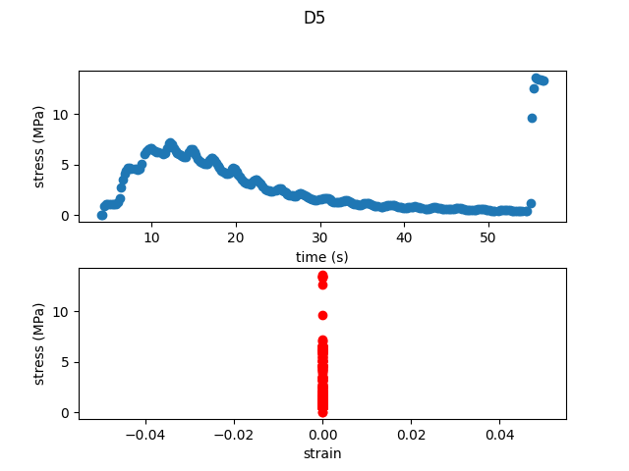
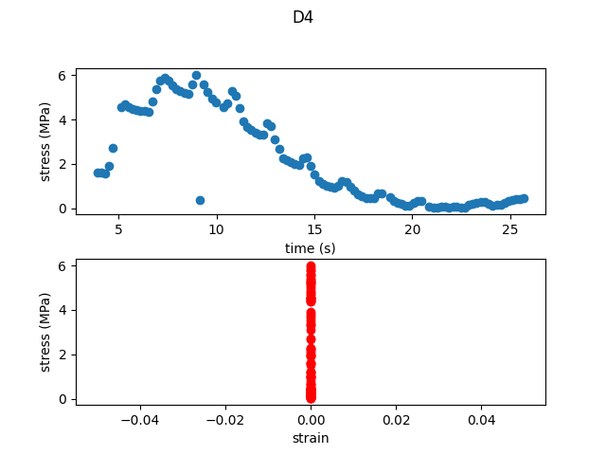
Damaged

Slide 7
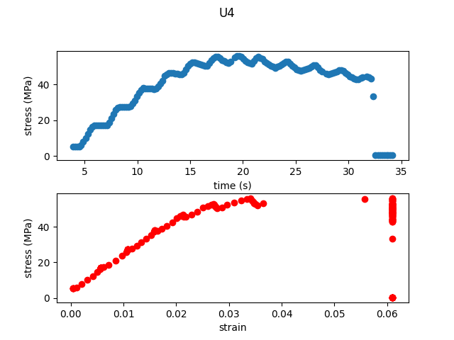
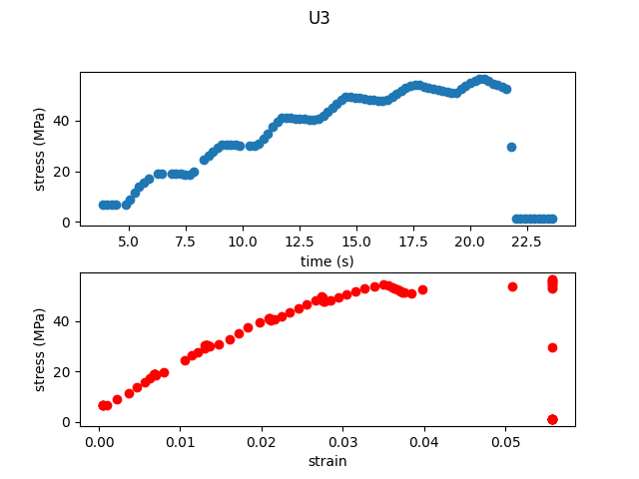
Undamaged

Slide 8
Data Analysis TODO
Go back and reorganize old data to fit new naming scheme.
Add metadata to data of how it was performed and concerns noted.

